Slide 1
Injuries in Professional and Collegiate Sports: Identifying Athletic Predisposition and Susceptibility to Injury and Analyzing Modern Incorporation of Biomedical Technology
By Peter Chapman
STAT468: Senior Research Project
University of Delaware
December 10, 2025

Slide 2
Introduction and Research Questions
Problem: High multitude of injuries that occur to athletes
Led to an increase in research on identifying injury risk and prevention within professional and collegiate athletics
Popular research topic in football, basketball, soccer, and baseball
Research Question 1: Are there predispositions to certain injuries for athletes of a certain size, position, sport, or activity? If so, what is the full extent of this susceptibility?
Several biomedical advancements within these sports have been made in previous seasons to address the rise in injuries
Research Question 2: Are modern advancements in injury risk and prevention effective in reducing the number of injuries?
Leagues analyzed: NFL, NHL, EPL, NCAA sports

Slide 3
Motivation and Hypotheses
Goal #1: Help identify potential causes of injuries in significant sports leagues
Goal #2: Evaluate technological advancements that were recently implemented into collegiate and professional athletics
Hypothesis #1: Certain external and internal factors contribute to determining likelihood of injury
  External factors: Playing surface, player position, quality of protective equipment
  Internal factors: Age, previous injuries, height and weight
Hypothesis #2: Biomedical and biomechanical advancements in athletics have been effective in reducing injuries, especially with common injuries and in sports with a high number of injuries
  Common injuries: Torn UCL for pitchers in baseball, concussions for running backs in football, etc.
  Leagues with many injuries: NFL, NHL, EPL, NCAA sports
Less confidence in the second hypothesis, as advancements are very recent and online research and data may be limited

Slide 4
Literature Review

Slide 5
External and Internal Factors
Internal Factors
Several internal factors affect likelihood and severity of injuries (Wentao)
  Age: Older age -> Higher risk
  Health status: Bad health -> Higher risk
  Physical condition: Height, weight, bone density, gender, flexibility
  Psychological factors: Self-esteem and self-identity
Similar findings and other significant internal factors (Taimela, et al.)
  Injury history: Signficant if not properly treated
  Weight: Heavier weight -> Higher risk
  Height: Taller height -> Higher risk
External Factors
Many characteristics can be considered external risk factors (Bahr and Holme)
  Human factors
    Referee decisions
    Opponent behavior
    Team playstyle
  Protective factors
    Equipment designed to protect athletes
    Shin guards, helmets, etc.
  Sports equipment
    All other equipment that is used
    Gloves, sticks, baseball bats, etc.
  Environment
    Weather: Rain, snow, ice, etc.
    Field or floor type, quality of the playing surface

Slide 6
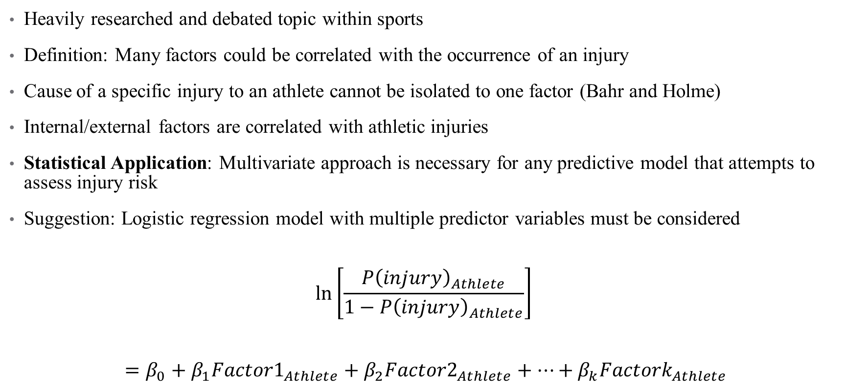
Multifactorial Nature of Injury
Heavily researched and debated topic within sports
Definition: Many factors could be correlated with the occurrence of an injury
Cause of a specific injury to an athlete cannot be isolated to one factor (Bahr and Holme)
Internal/external factors are correlated with athletic injuries
Statistical Application: Multivariate approach is necessary for any predictive model that attempts to assess injury risk
Suggestion: Logistic regression model with multiple predictor variables must be considered
$$\ln\left[\frac{{P\left(injury\right)}_{Athlete}}{1−{P\left(injury\right)}_{Athlete}}\right]$$
$$={β_{0}+β}_{1}{Factor1}_{Athlete}+β_{2}{Factor2}_{Athlete}+…+β_{k}{Factork}_{Athlete}$$

Slide 7
Biomechanical and Biomedical Advancements in Athletics
Rapid development as technology improves, especially in the 21st century
Some advancements target a specific injury as opposed to a certain sport or athlete type
  Non-contact knee injuries (ACL, PCL, meniscus injuries)
    Research into playing surface and field upkeep (artificial or natural field)
    Improvements in footwear (cleats, basketball shoes, skates)
  Head and concussion injuries (Nath, et al.)
    High-tech materials (carbon fiber and polycarbonate) used for hockey and football helmets
    Creation of the Guardian Cap in professional and collegiate football
Other advancements are general across all sports (Nath, et al.)
  Smart fabrics that collect vital signs, assess fatigue, and motor functions
  Wearable technology such as GPS trackers, LPS trackers, augmented reality
  Embedded sensors that collect movement patterns, forces, athlete posture
  Artificial intelligence can make predictions and recommendations from data

Slide 8
Methodology

Slide 9
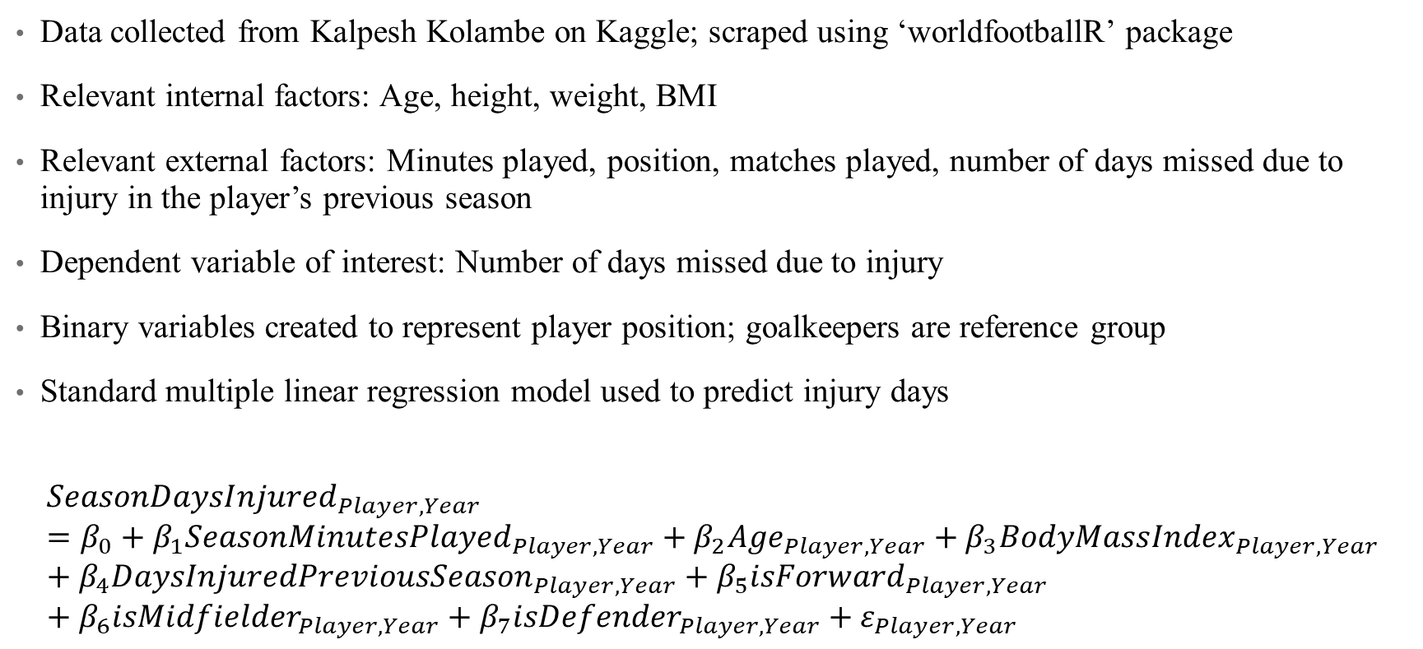
English Premier League Model for Injury Days Missed
Data collected from Kalpesh Kolambe on Kaggle; scraped using ‘worldfootballR’ package
Relevant internal factors: Age, height, weight, BMI
Relevant external factors: Minutes played, position, matches played, number of days missed due to injury in the player’s previous season
Dependent variable of interest: Number of days missed due to injury
Binary variables created to represent player position; goalkeepers are reference group
Standard multiple linear regression model used to predict injury days
$${SeasonDaysInjured}_{Player, Year}=β_{0}+β_{1}{SeasonMinutesPlayed}_{Player, Year}+β_{2}{Age}_{Player, Year}+β_{3}{BodyMassIndex}_{Player, Year}+β_{4}{DaysInjuredPreviousSeason}_{Player, Year}+β_{5}{isForward}_{Player, Year}+β_{6}{isMidfielder}_{Player, Year}+β_{7}{isDefender}_{Player, Year}+ε_{Player, Year}$$

Slide 10
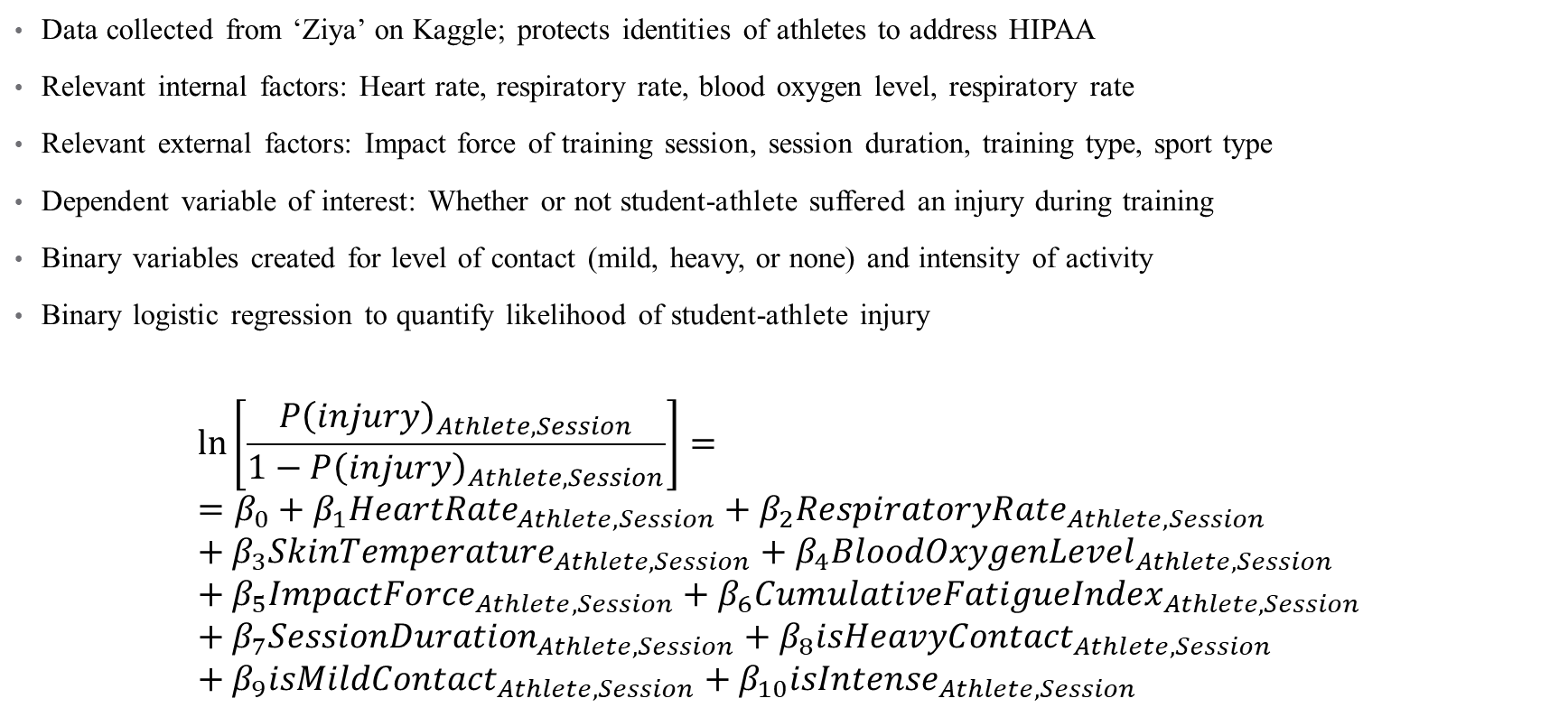
Binary Logistic Regression for Injury Likelihood in NCAA Training Sessions
Data collected from ‘Ziya’ on Kaggle; protects identities of athletes to address HIPAA
Relevant internal factors: Heart rate, respiratory rate, blood oxygen level, respiratory rate
Relevant external factors: Impact force of training session, session duration, training type, sport type
Dependent variable of interest: Whether or not student-athlete suffered an injury during training
Binary variables created for level of contact (mild, heavy, or none) and intensity of activity
Binary logistic regression to quantify likelihood of student-athlete injury
$$\ln\left[\frac{{P\left(injury\right)}_{Athlete, Session}}{1−{P\left(injury\right)}_{Athlete, Session}}\right]= ={β_{0}+β}_{1}{HeartRate}_{Athlete, Session}+β_{2}{RespiratoryRate}_{Athlete, Session}+β_{3}{SkinTemperature}_{Athlete, Session}+β_{4}{BloodOxygenLevel}_{Athlete, Session}+β_{5}{ImpactForce}_{Athlete,Session}+β_{6}{CumulativeFatigueIndex}_{Athlete, Session}+β_{7}{SessionDuration}_{Athlete, Session}+{β_{8}isHeavyContact}_{Athlete, Session}+{β_{9}isMildContact}_{Athlete, Session}+{β_{10}isIntense}_{Athlete, Session}$$

Slide 11
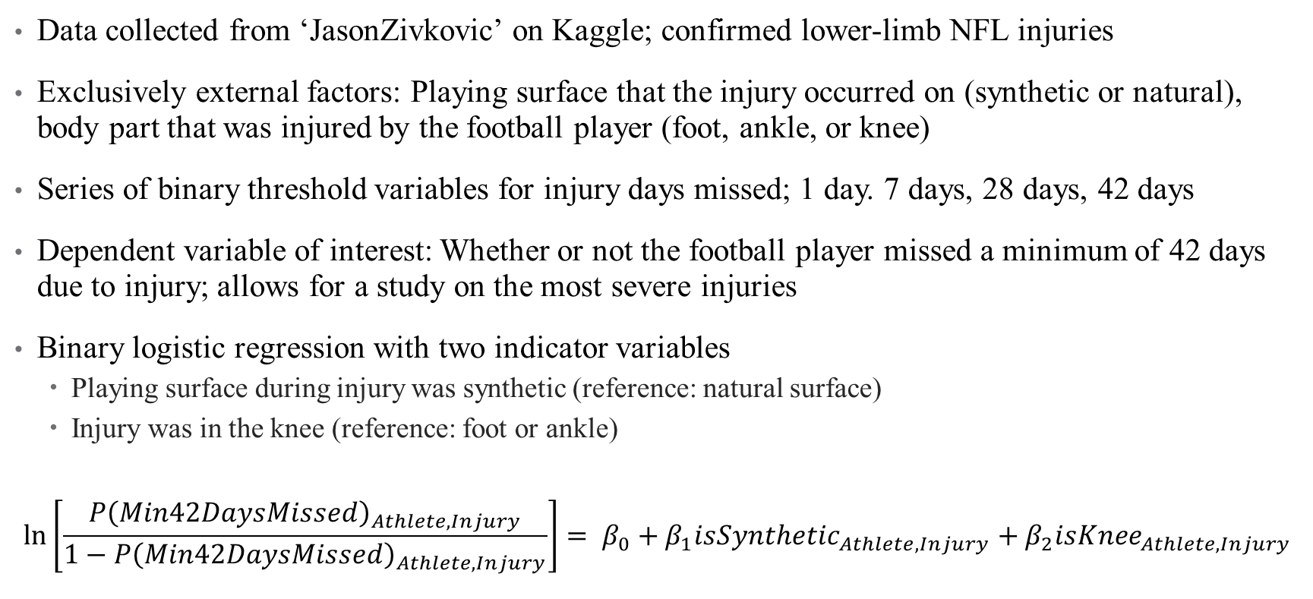
NFL Playing Surface and Injury Severity Binary Logistic Regression Model
Data collected from ‘JasonZivkovic’ on Kaggle; confirmed lower-limb NFL injuries
Exclusively external factors: Playing surface that the injury occurred on (synthetic or natural), body part that was injured by the football player (foot, ankle, or knee)
Series of binary threshold variables for injury days missed; 1 day. 7 days, 28 days, 42 days
Dependent variable of interest: Whether or not the football player missed a minimum of 42 days due to injury; allows for a study on the most severe injuries
Binary logistic regression with two indicator variables
  Playing surface during injury was synthetic (reference: natural surface)
  Injury was in the knee (reference: foot or ankle)
$$\ln\left[\frac{{P\left(Min42DaysMissed\right)}_{Athlete, Injury}}{1−{P\left(Min42DaysMissed\right)}_{Athlete, Injury}}\right]= {β_{0}+β}_{1}{isSynthetic}_{Athlete, Injury}+β_{2}{isKnee}_{Athlete, Injury}$$

Slide 12
NHL Injury Trends by Position
Data collected and provided by an online database called NHL Injury Viz
Position group recorded for each injury (defenseman, forward, goaltender)
Injured body part provided for each observation
  Very specific injuries: Appendicitis, bronchitis, dehydration, COVID-19
  More broad injury location: Upper-body, lower-body, mid-body, arm, leg, foot, head
Data from 2000-01 to 2025-26, including playoffs
Both number of days missed and count of each injury provided
Data visualizations created using Tableau Public software
  Heat map showing frequency of injury type by the three positions
  Line graph showing injury trends over time by position group

Slide 13
Results and Discussion

Slide 14
EPL Injury Days Missed Model Outcomes
Model R-squared of 11.39% reinforces idea of multifactorial nature of injury
Statistically significant factors: Season minutes played, days injured in the previous season
Clinically significant factors: Age, variables representing player position
Defenders are predicted to miss the most days due to injury, followed by midfielders, forwards, and then goalkeepers
Season minutes played and BMI have negative relationships with days missed
Age and days missed in previous season have positive relationships
Variable | Coefficient | P-Value
Intercept | 88.569744 | 0.01616
Season Minutes Played | -0.027323 | <0.0001
Age | 0.969747 | 0.10979
Body Mass Index (BMI) | -0.496373 | 0.75396
Days Injured in Previous Season | 0.086429 | 0.00467
isForward | 10.634257 | 0.26964
isMidfielder | 12.337696 | 0.16918
isDefender | 17.0408 | 0.05643

Slide 15
NCAA Training Sessions Binary Logistic Regression Model Results
Multicollinearity existed between two pairs of factors; one variable removed from each pair
  Blood oxygen level percentage and skin temperature in degrees Celsius
  Heart rate (beats per minute) and respiratory rate (breaths per minute)
Statistically significant factors: Impact of force (N) of session, cumulative fatigue index, blood oxygen level percentage
Clinically significant factors: Contact level of sport played
Variable | Coefficient | P-Value
Intercept | 13.315 | <0.0001
Heart Rate (BPM) | -0.00279 | 0.3334
Blood Oxygen Percent Level | 0.1196 | <0.0001
Impact of Force (N) | -0.00597 | 0.0001
Cumulative Fatigue Index | -1.9031 | <0.0001
Duration of Session (min) | -0.00162 | 0.6241
isHeavyContact | 0.3394 | 0.0606
isMildContact | -0.0294 | 0.8452
isIntense | -0.124 | 0.365

Slide 16
NFL Playing Surface and Injury Severity Binary Logistic Regression Model
$$\ln\left[\frac{{P\left(Min42DaysMissed\right)}_{Athlete, Injury}}{1−{P\left(Min42DaysMissed\right)}_{Athlete, Injury}}\right]= 0.7832−0.1642{isSynthetic}_{Athlete, Injury}+0.3992{isKnee}_{Athlete, Injury}$$
Both variables statistically insignificant at the 5% level
May both hold clinical significance due to health and safety setting
Interpretations can be developed from the odds ratio estimates
  Knee injury increases likelihood of missing 42 days by 49.1%
  Synthetic surface is associated with a 15.1% decrease in the likelihood of missing 42 days due to injury
Variable | Coefficient | P-Value
Intercept | 0.7832 | <0.0466
isSynthetic | -0.1642 | 0.7119
isKnee | 0.3992 | 0.3682

Slide 17
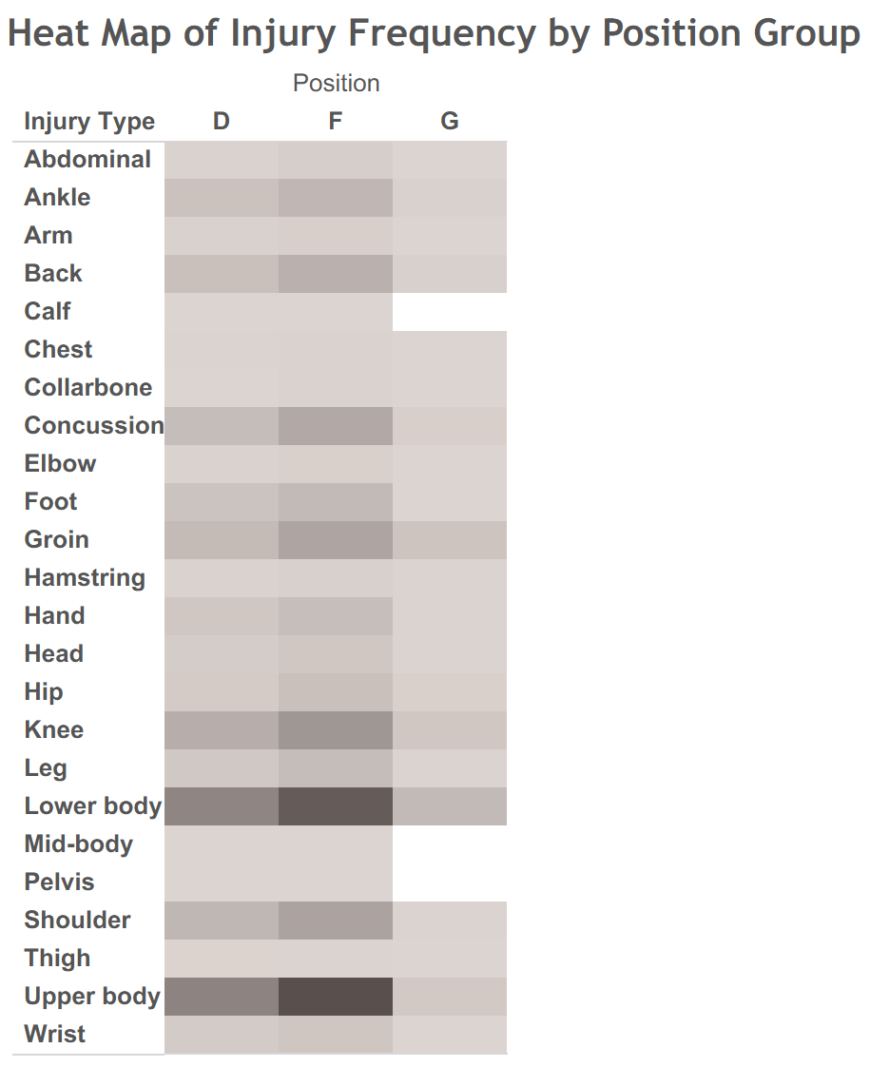
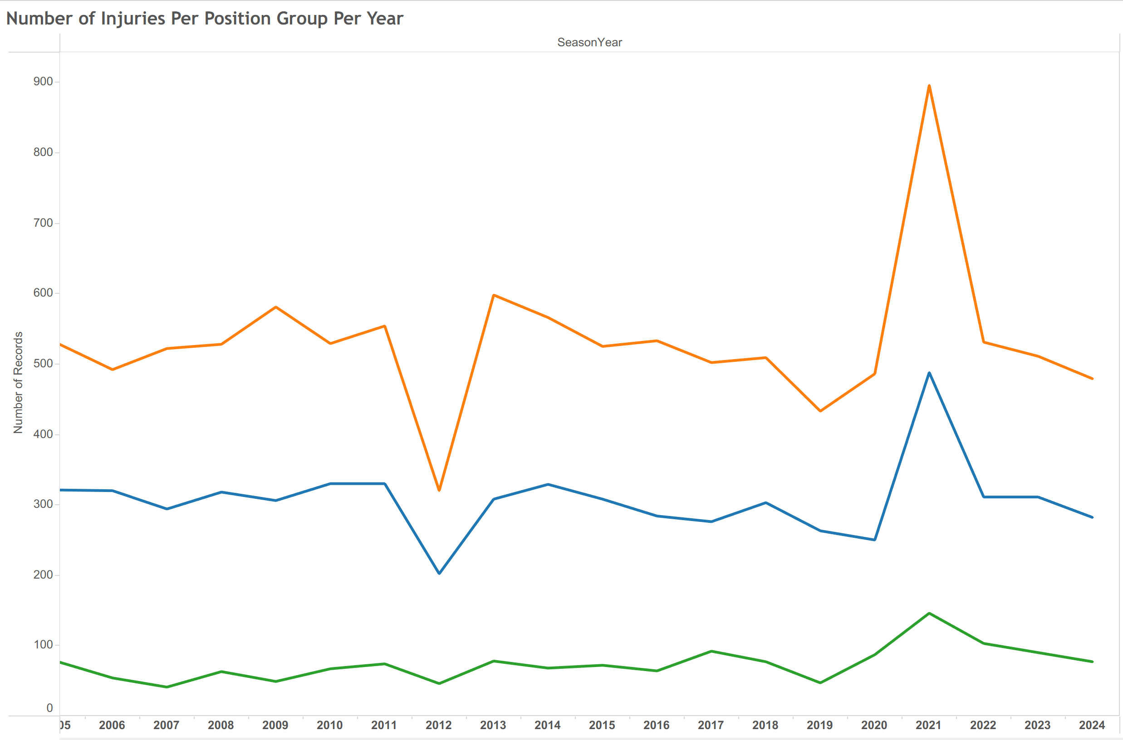

Slide 18
Impact of Guardian Caps on Concussions
Collegiate Level (NCAA)
Study from MIT’s collegiate team (Carratu)
Two different tests to evaluate
  Visual response test
  Physical perception test
Players naturally grouped into two categories
  Treatment group: Wore Guardian Caps
  Control group: Did not wear Guardian caps
Two conclusions made from the study
  No statistically significant difference between the two groups
  Guardian Cap group had less variation for response speed, eye response constriction, tracking ability
Professional Level (NFL)
Laboratory testing of the Guardian Cap NXT (Funk, et al.)
Setting: Preseason practices from 2018 to 2023
  Excludes the 2020 preseason
  2022: Linemen, linebackers, and tight ends required
Controls included to isolate effect of Guardian Caps
  Practice intensity (pads or no pads)
  Player position (offensive lineman, defensive lineman, linebacker, tight end)
Two main takeaways
  Concussion rate for Guardian cap players decreased 54% after helmets were introduced
  Could not be solely attributed to the Guardian Cap NXT

Slide 19
Conclusion and Future Research
Statistical findings are best to be interpreted by sport as correlations
  Professional soccer: Minutes played, days missed due to injury in previous season
  Collegiate sports: Contact level, blood oxygen level percentage, cumulative fatigue index, and total impact of forces during the training session
  National Football League: Higher risk of severe injury on natural playing surface
Conclusion: Mix of internal and external factors (multifactorial nature of injury)
  Results vary across sport, level, and physical activity
  Injury likelihood and severity cannot be generalized across all sports
Future research can make this study even more accurate
  Full populations are largely better than small samples of injuries
  Regression estimates would become more accurate
  Model would hold higher relevance for predicting injuries and their severity

Slide 20
Limitations
Difficulty in finding free, public data
  Many leagues are very private with their injury data
  Most data sets are behind paywalls or have restrictions on user access
  Leagues excluded: Major League Baseball (MLB), National Hockey League (NHL), National Association of Stock Car Auto Racing (NASCAR)
Collected data sets were samples, not full populations of injury
  Required assumption: Samples are representative of full populations of injuries
  Statistical effects are estimates of true population effects
Recency of biological and technological advancements
  Limited amount of available data for evaluating effectiveness
  Advancements and progress are constantly being made

Slide 21
Acknowledgements
Professor Bryan Crissinger
  University of Delaware Department of Applied Economics and Statistics
  STAT468: Senior Research Project faculty advisor for this semester-long project
  Provided advice on topic, research questions, data collection and transformation, statistical and data analysis, rough draft, and presentation
Professor Patrick DeFeo
  University of Delaware College of Agriculture and Natural Resources
  STAT611: Regression Analysis Instructor
  Key concepts: Regression techniques, binary logistic regression, multicollinearity among predictors
Professor Jack Davis
  Associate Director of Business Intelligence, Analytics, and Strategy at the University of Delaware Athletic Department
  SPAX402: Predictive Analysis with Athletics Data Instructor
  Key concepts: Microsoft Excel, Microsoft Power Query, data collection and transformation methods

Slide 22
Literature Review Works Cited
Bahr, R, and Holme, I. “Risk Factors for Sports Injuries -- a Methodological Approach.” British Journal of Sports Medicine, vol. 37, no. 5, 1 Oct. 2003, pp. 384–392, bjsm.bmj.com/content/37/5/384, https://doi.org/10.1136/bjsm.37.5.384. Accessed 27 Sept. 2025.
Carratu, Christopher. “Guardian Cap Effectiveness on Reducing Impact Accelerations and Enduring Player Health at the Collegiate Football Level.” Mit.edu, 23 June 2025, dspace.mit.edu/handle/1721.1/162566, https://hdl.handle.net/1721.1/162566. Accessed 7 Dec. 2025.
Funk, James R., et al. “An Analysis of Guardian Cap Use and Changes in the Concussion Rate in National Football League Preseason Practices from 2018 to 2023.” The American Journal of Sports Medicine, 2 July 2025, journals.sagepub.com/doi/full/10.1177/03635465251351288, https://doi.org/10.1177/03635465251351288. Accessed 7 Dec. 2025.
Nath, Debraj, et al. “View of Progress of Protective Gear in Preventing Sports Injuries.” Brazilianjournals.com.br, 2025, ojs.brazilianjournals.com.br/ojs/index.php/BRJD/article/view/67830/48261. Accessed 6 Dec. 2025.
Taimela, Simo, et al. “Intrinsic Risk Factors and Athletic Injuries.” Sports Medicine, vol. 9, no. 4, Apr. 1990, pp. 205–215, link.springer.com/article/10.2165/00007256-199009040-00002, https://doi.org/10.2165/00007256-199009040-00002. Accessed 27 Sept. 2025.
Wentao, Zhao. “Analysis of the Causes of Sports Injuries in Sports Training.” Frontiers in Sport Research, vol. 6, no. 1, 2024, francis-press.com/uploads/papers/GABe79pq5P7HyzaqpGLsIxYGW4JZwvH1lJHfA1eT.pdf, https://doi.org/10.25236/fsr.2024.060106. Accessed 27 Sept. 2025.

Slide 23
Data Sources
https://www.kaggle.com/datasets/ziya07/college-sports-injury-detection
https://www.kaggle.com/datasets/kolambekalpesh/football-player-injury-data?resource=download
https://www.kaggle.com/code/jaseziv83/an-analysis-of-nfl-injuries
https://nhlinjuryviz.blogspot.com/p/index-page.html

